Slide 1
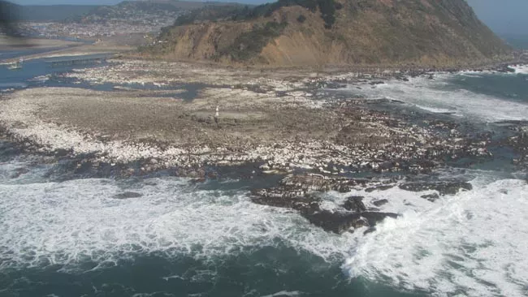
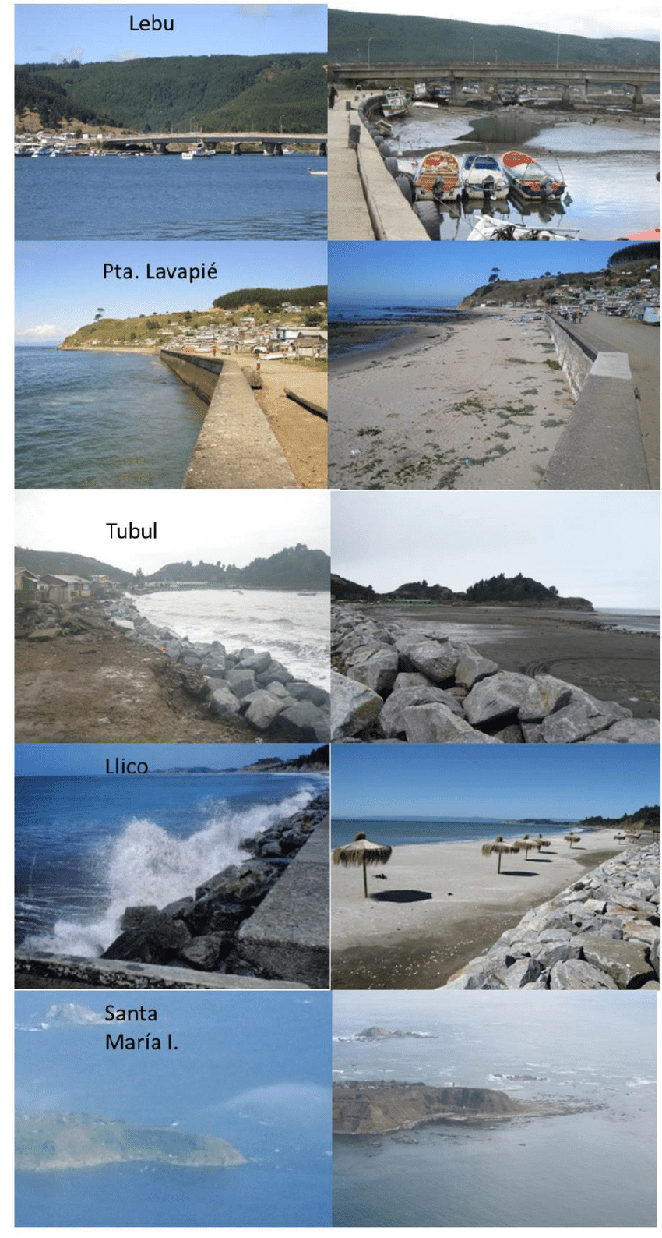
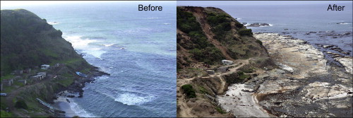
July 2010, B. I. 29. (2010). Huge Chilean Earthquake Raised Country’s Coast. Livescience.com. https://www.livescience.com/6795-huge-chilean-earthquake-raised-country-coast.html

Slide 2
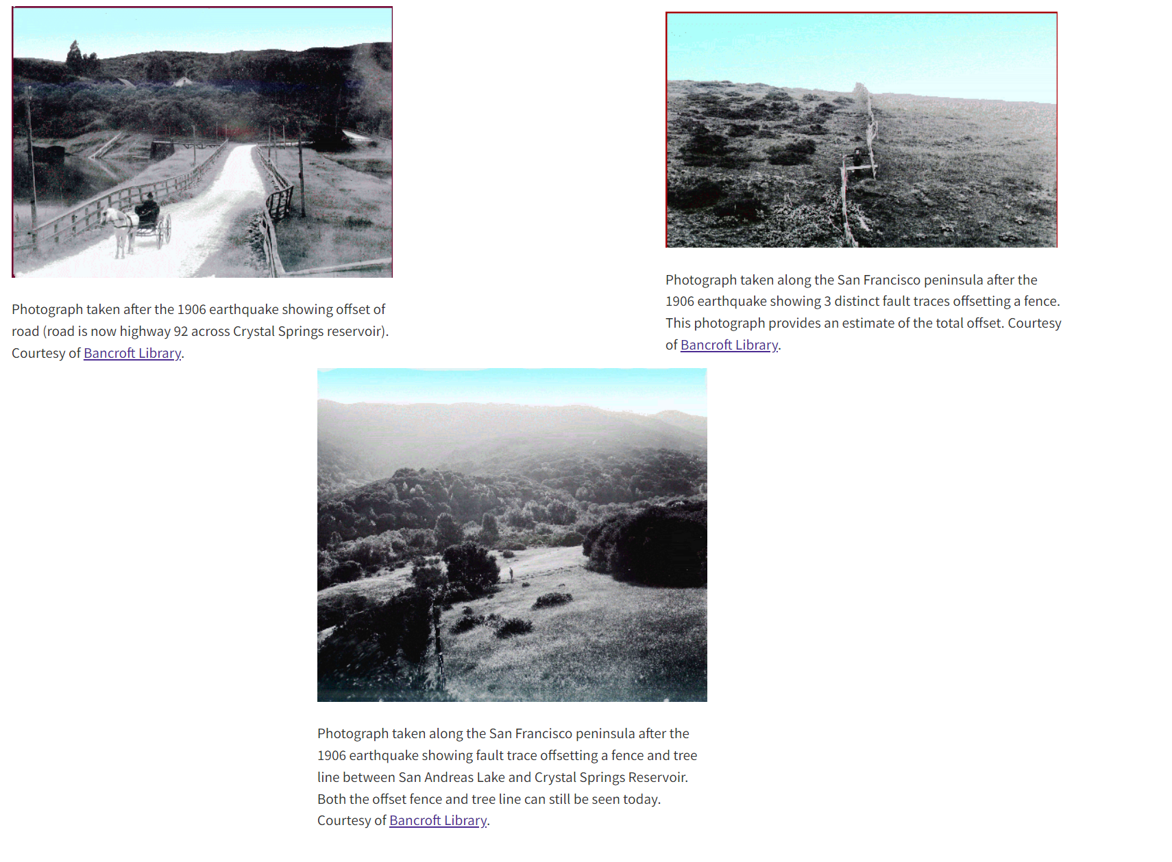
1906 Historical research on the San Andreas Fault. (n.d.). Earthquake.usgs.gov. https://earthquake.usgs.gov/earthquakes/events/1906calif/18april/historical.php

Slide 3
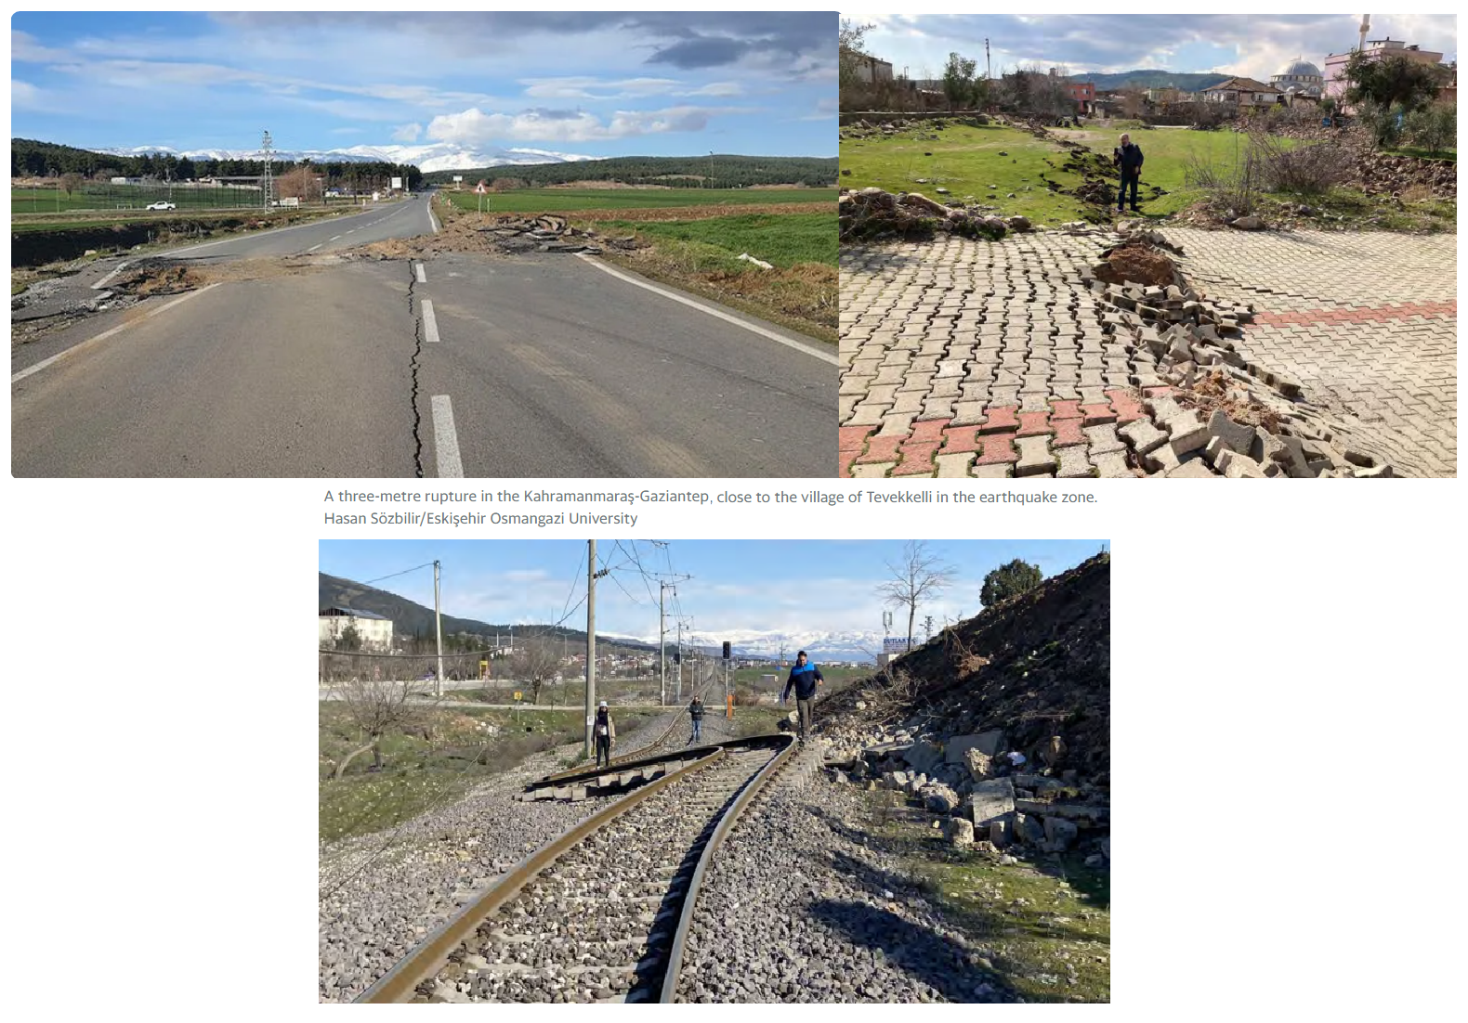
Duman, E., Lozano, J., & Nichols, E. (2023). 2023 Turkey Earthquake Virtual Report on Geotechnical Impacts Report Date: 2/9/2023 Geotechnical Extreme Events Reconnaissance (GEER) Association Turning Disaster into Knowledge. Retrieved August 3, 2023, from https://www.spolmik.org/wp-content/uploads/2023/02/GEER_-2023-Turkey-EQ-Virtual-Report_c.pdf

